Slide 1
Channel Access Security
Kay Kasemir
ORNL/SNS
kasemirk@ornl.gov
Feb. 2013
Material copied from the IOC Application Developer's Guide
Marty Kraimer, Janet Anderson, Andrew Johnson (APS) and others

Slide 2
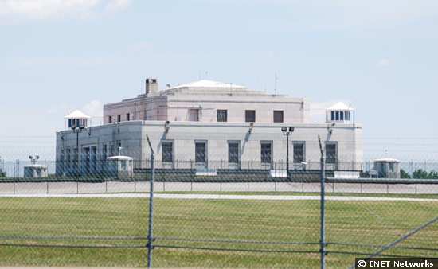
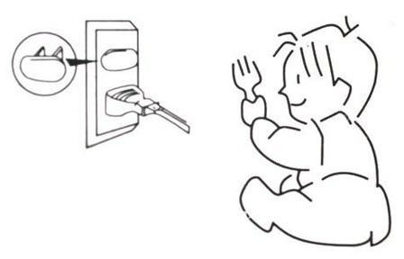
“Security”?
Not like this
  Fend off malicious hackers, evildoers, long-haired troublemakers?
More like this
  Prevent casual users from making mistakes!
  Help operators follow procedures!
http://asset3.cbsistatic.com/cnwk.1d/i/ne/p/2008/FortKnox_550x338.jpg
http://i01.i.aliimg.com/img/pb/216/247/491/491247216_377.jpg

Slide 3
Idea
Control reading and/or writing via Channel Access
  Almost never used to limit reading
Criteria:
Who?
  Control system engineer may always access everything
  Beam Line Staff may always access most things
  Beam Line Users cannot write certain things
From Where?
  Full access from Beam Line Control Room
  No write access from anywhere else
When
  Read-only while experiment is running, while automation is enabled, …
  Writable when experiment idle, manual control enabled, …

Slide 4
Limitations
… Via Channel Access
  Nothing is encrypted
  IOC console (dbpf, …) not affected
Who?
  $USER
From Where?
  Host name, easy to fake

Slide 5
Records…
Assigned to Access Security Group
  field(ASG, "LIMITED")
  Default is “DEFAULT”
Fields have Acc. Sec. Level
  Most in ASL1
  Some are ASL0
  Nobody can remember. See *.dbd

Slide 6
Configuration
Doing nothing is equivalent to this:
  Create file ”simple.acf":
  ASG(DEFAULT)
  {
  RULE(1, READ)
  RULE(1, WRITE)
  }
  Add this line to your st.cmd:
  asSetFilename("path_to_the_file/simple.acf")
Result:
  By default, records use the "DEFAULT" ASG.
  … which allows full read/write.
  The 'asprules' and 'asdbdump' commands now show something
Caveat:
  If the AS config file does not exist or contains an error, all access is prohibited!
  Use 'ascheck' on the host before loading a file into the IOC.

Slide 7
Read-Only Example
Group that allows read, but no write:
ASG(READONLY)
{
RULE(1, READ)
# Nothing in here about WRITE…
}
To have an effect, set the ASG field of at least one record to READONLY.
  You can change ASG fields at runtime.
  … via Channel Access, unless AS prohibits it…
'caput' will show that the old and new values stay the same
CSS BOY will change cursor when over read-only field.

Slide 8
List Specific Users and Hosts
Limit write access to
  members of a user access group UAG,
  while on a computer in the host access group HAG:
  UAG(x_users) { ubuntu }
  HAG(x_hosts) { ubuntu }
  ASG(X_TEAM)
  {
  RULE(1, READ)
  RULE(1, WRITE)
  {
  UAG(x_users)
  HAG(x_hosts)
  }
  }
Caveats:
  The CA client library sends the user and host names to the server. Especially the host name can be tricky:
  It's not the client's IP address!
  It's the result of the 'hostname' command,
  … which might differ from the DNS name
  The 'casr' command on the IOC can sometimes help to show who and from where is connecting via CA, and the 'asdbdump' command shows who they pretend to be.

Slide 9
Mode-Based
Limit write access to times where some variable meets some criteria
  ASG(MODE)
  {
  INPA(tx:setpoint)
  RULE(1, READ)
  RULE(1, WRITE)
  {
  CALC(A < 50)
  }
  }
This is based on the same code as the 'CALC' record
  One can assign inputs 'A' to 'L'.
  The computation should result in 0 or 1, the latter allowing access.

Slide 10
RULE(<level>, <what>)
<level> is 0 or 1.
  The dbd file assigns each field to an access security level. Fields that are typically changed during operation are on level 0.
    Example: For the AI record, VAL is level 0, the rest is level 1.
  Rules for level 1 also grant access to level 0.
  Example: Everybody can write 'VAL' (level 0), but restrict other fields:
  ASG(WRITE_SOME)
  {
  RULE(1, READ)
  RULE(0, WRITE)
  RULE(1, WRITE)
  {
  UAG(x_users)
  HAG(x_hosts)
  }
  }
<what> is NONE, READ, or WRITE
  Plus an optional TRAPWRITE, which will cause invocation of a 'trap write listener', i.e. custom C code that might be added to the IOC.
  This can be used to log write access by user and host, it doesn't otherwise affect access security.

Slide 11
Example from CG-1D
Access rules
https://trac.sns.gov/slowcontrols/browser/cg1d/applications/scanApp/Db/scan.acf
Record adjustments
https://trac.sns.gov/slowcontrols/browser/cg1d/applications/motorApp/Db/motorutil.db

Slide 12
Better “Security”
Place IOCs in private network
  No ‘telnet’ to their console
  No Channel Access from malicious clients
  Outside access (ssh, NXClient, …) controlled the usual way
Add Channel Access Gateway to other networks
  Gateway also has access security
  Make it read-only

Slide 13

And that's all
I have to say about that!

